Slide 1
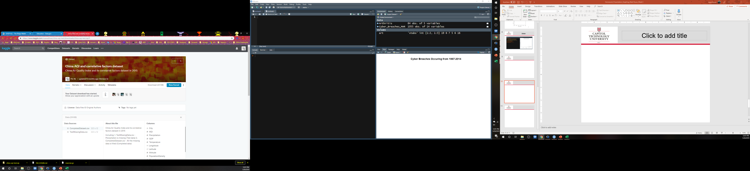
What should you include?
Which dataset you chose to analyze?
China’s Air Quality Index (AQI)
Ni, Pin. (2015). China AQI and correlative factors dataset in 2015 (Version 5) [Data file and code book]. Retrieved from https://www.kaggle.com/maxwellnee/china-aqi-test

Slide 2
What should you include? (cont.)
What makes this dataset important?
Many quantitative data points
(Had to discard original)
Provides many insights can be determined of AQI in comparison to other correlative factors
Precip., GDP, temp., pop density, coastal, etc.
What research questions you are asking (sample)?
Relationship between AQI and GDP
Relationship between AQI and country location (coastal [binary])
Relationship between AQI and Altitude

Slide 3
What should you include? (cont.)
How the dataset applies to a specific business decision?
Where to locate a business in China based on “quality of life”?
AQI, GreenCoverage, Incineration
Which areas are the most prosperous?
Enough employees [PopulationDensity]
Skills available [high GDP])
Why your analysis would be important and/or how it closes gaps in knowledge?
Identifies critical environmental and health factors for China and China operations
Would locate optimal business locations [closes gap].
Good AQI and good access to resources

Slide 4
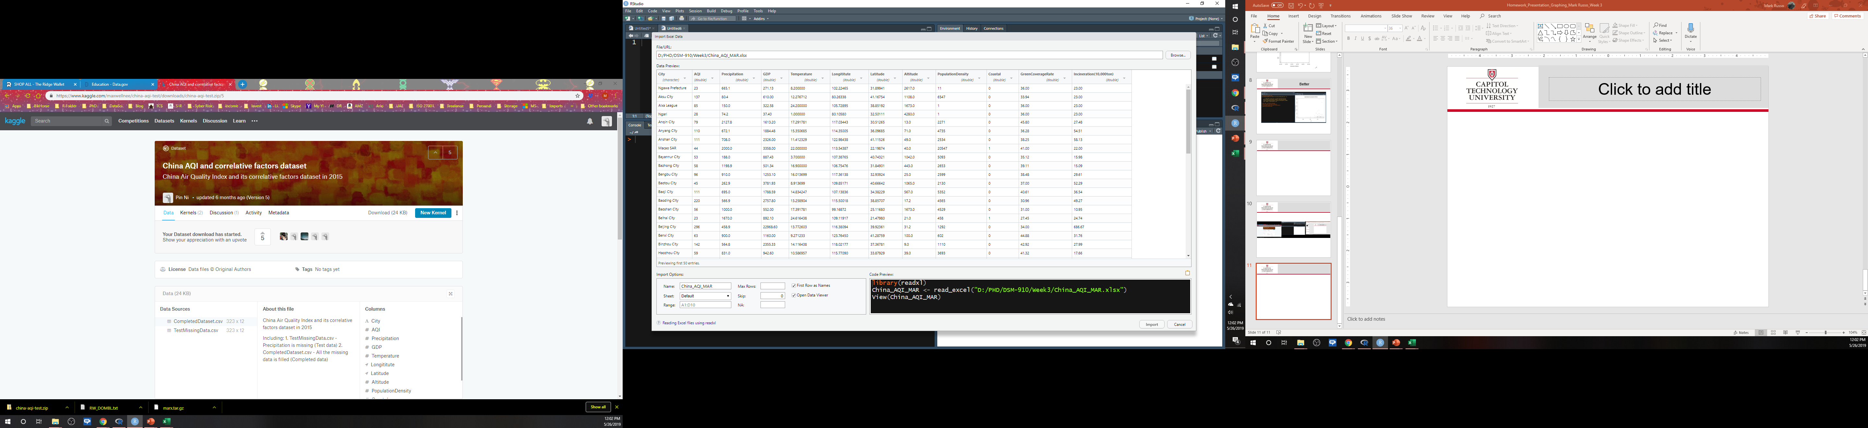
My_Dataset
Retrieved data
Multiple quant. data points

Slide 5
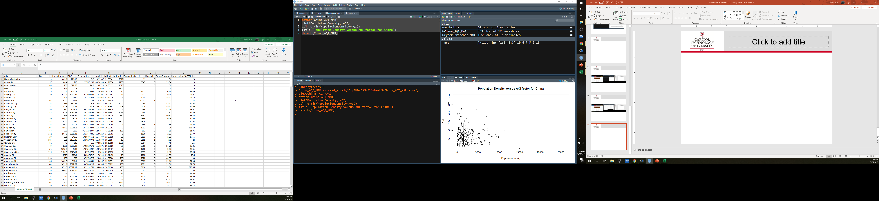
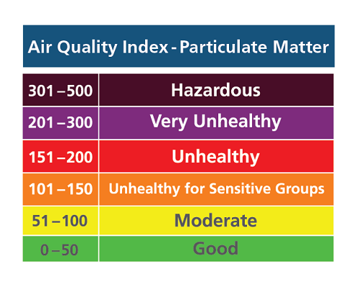
Population Density v. AQI
R Studio extract
Density not a major factor
SOURCE: http://www.sparetheair.com/aqi.cfm

Slide 6
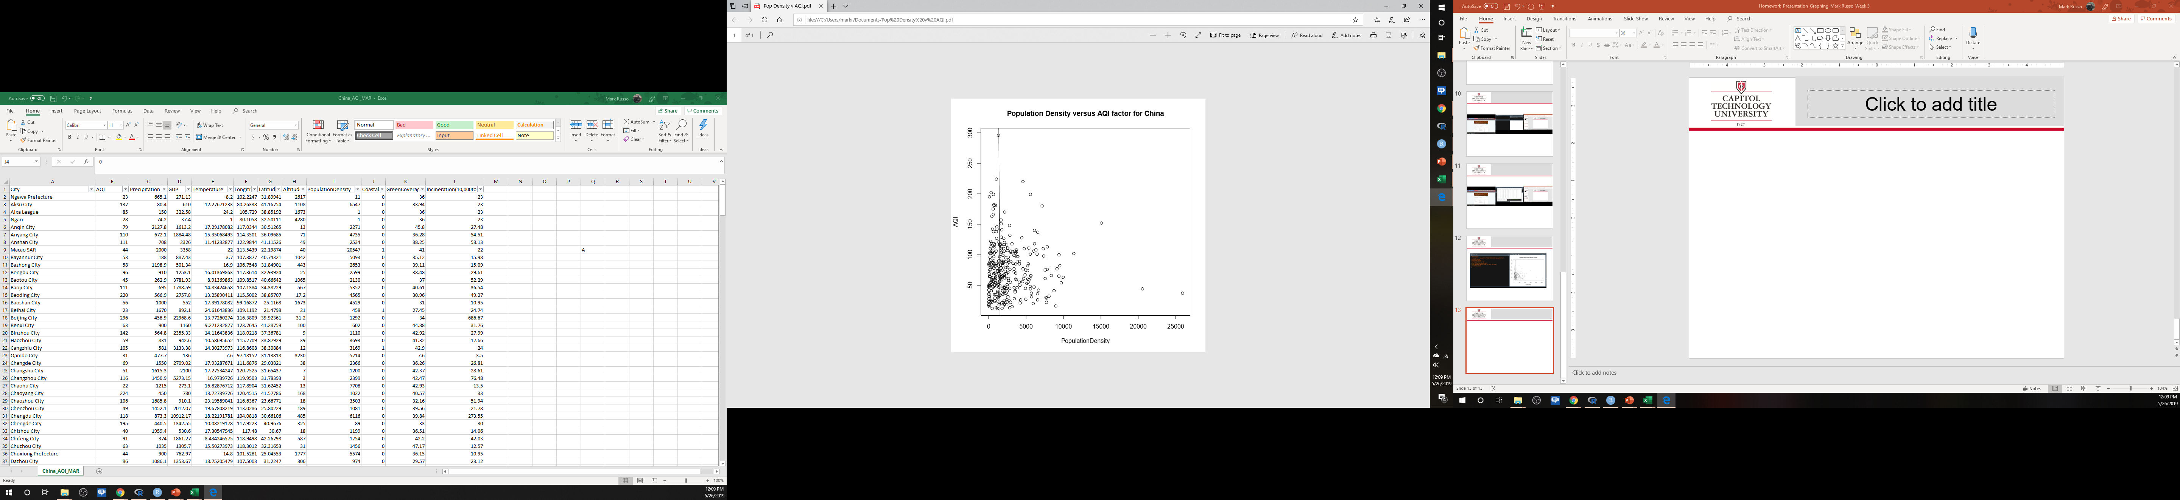
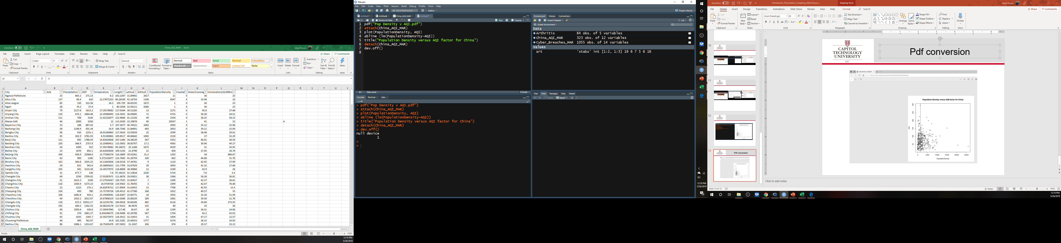
Pdf conversion
Jpg conversion too with original dataset

Slide 7
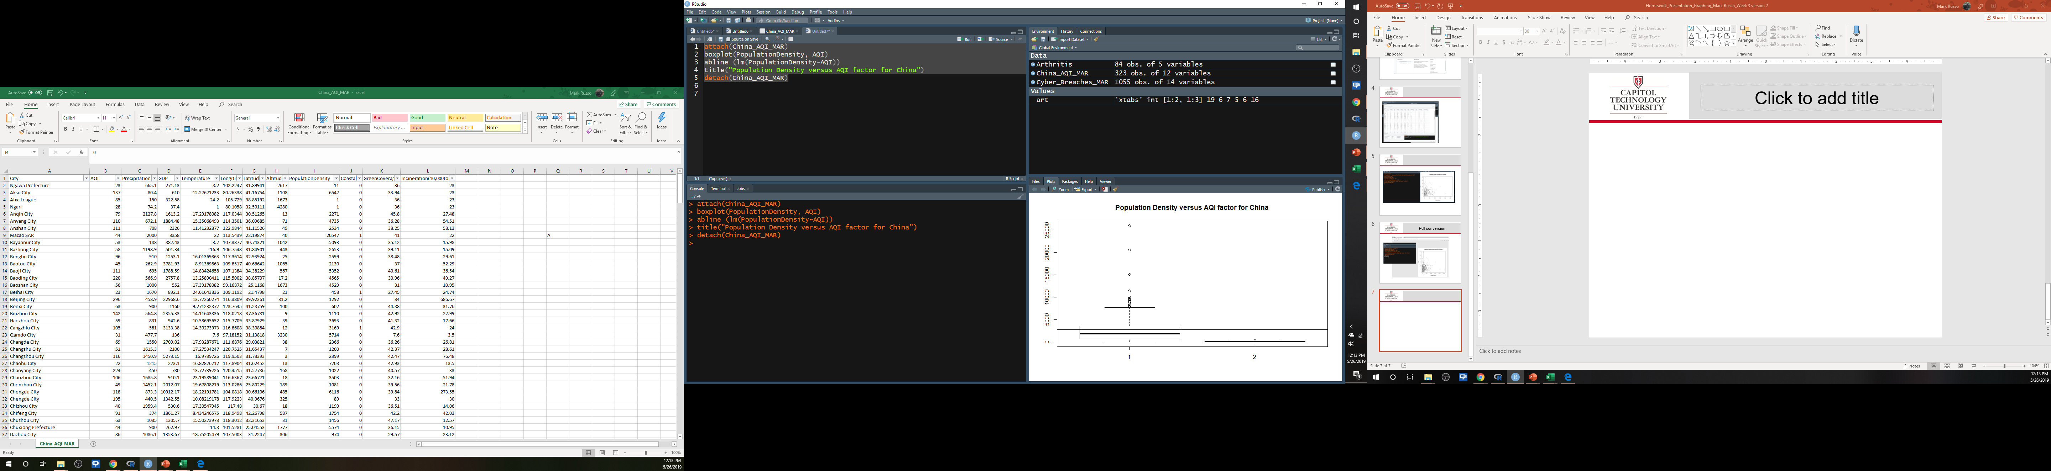
Boxplot
Hist() and boxplot() not real helpful with this data

Slide 8
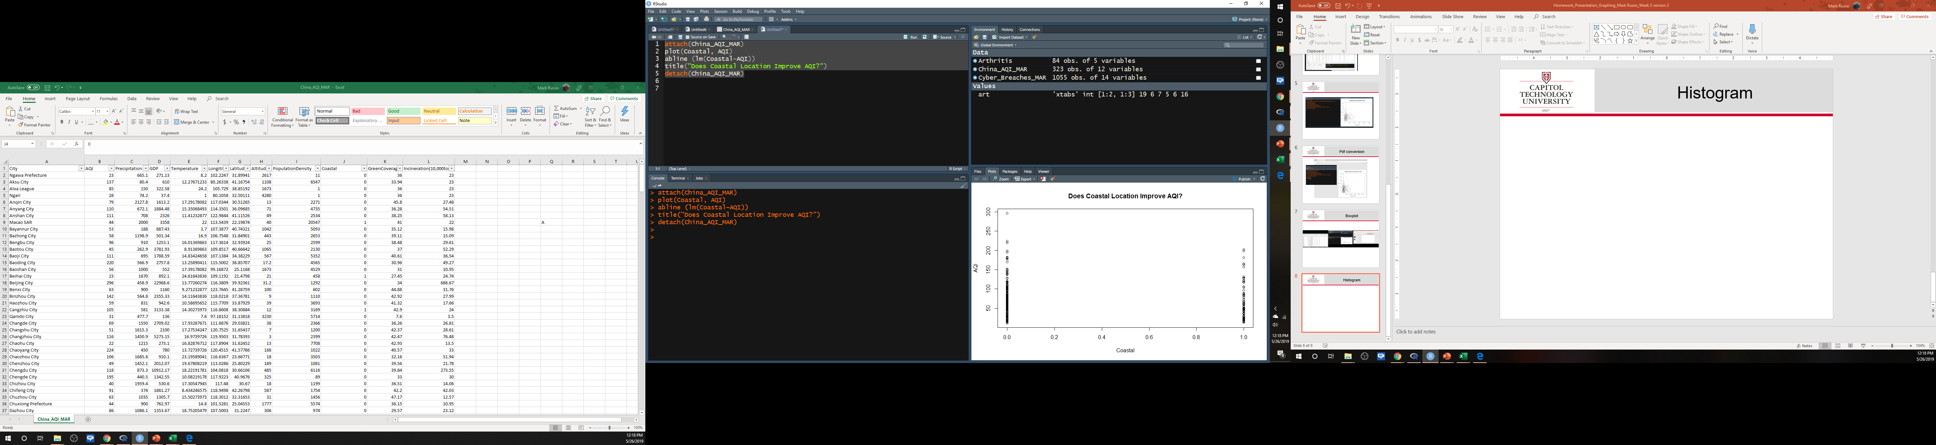
Is AQI Better on Coast? No
0 = Not coastal
1 = Coastal
No real difference

Slide 9
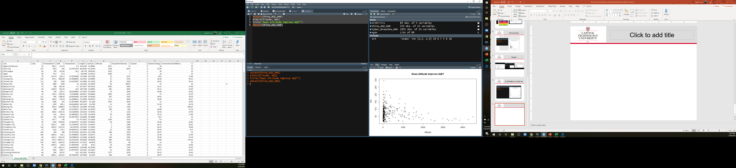
Does Altitude Improve AQI? Yes
Altitude is better for lower AQI
Sea Level [coastal] worse

Slide 10
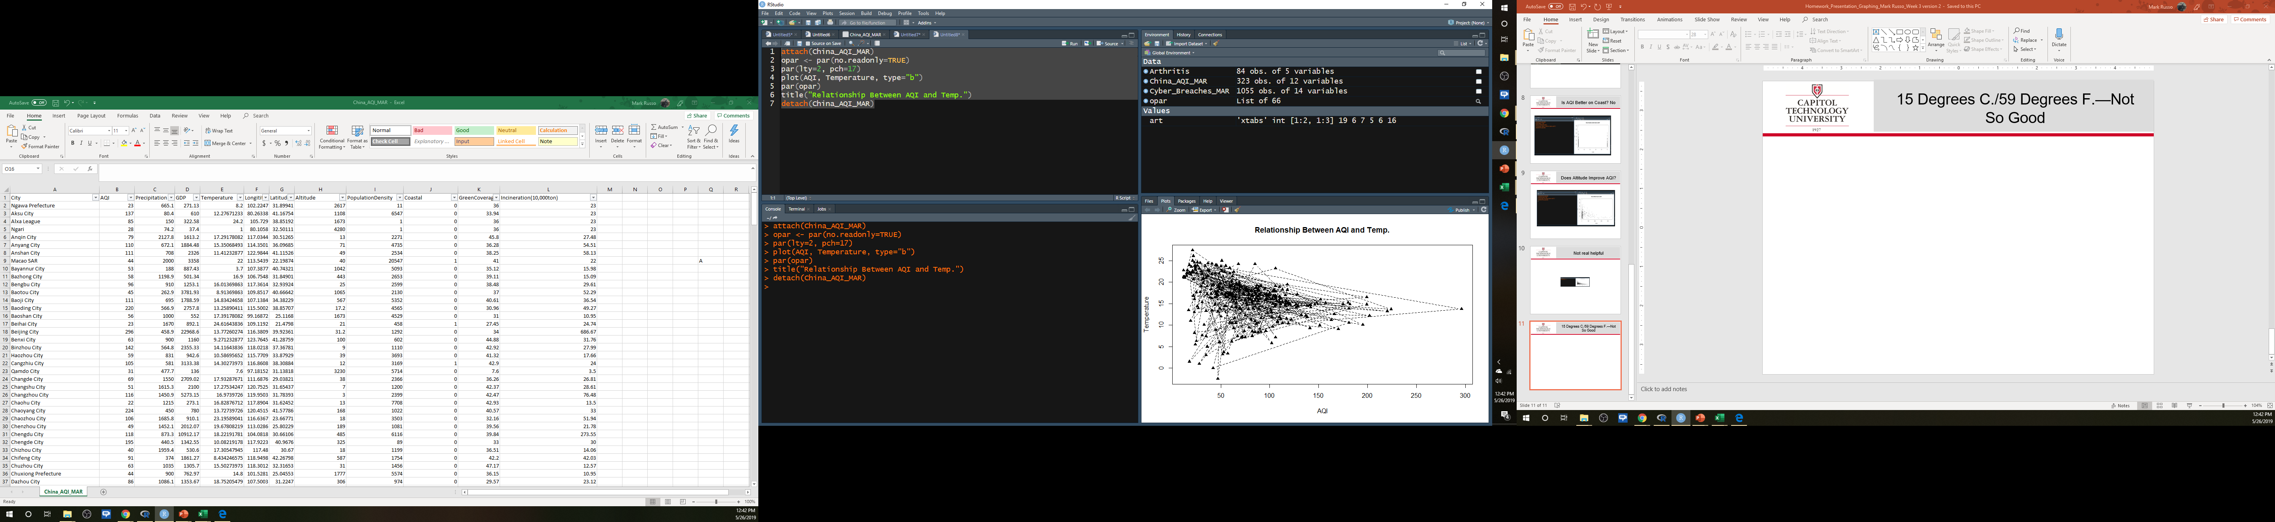
14⁰ C./58 ⁰ F.—Not So Good for YOUR health in China
par() function
Line type and plot symbol
Temperature MAY influence AQI
GUESS WHO?

Slide 11
ANSWER: Beijing

Slide 12
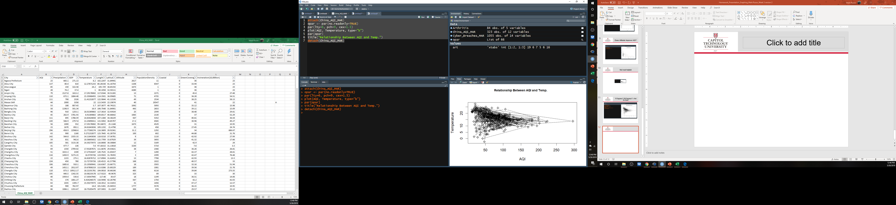
Adjusting par()
par() function
Line type, plot symbol, symbol size

Slide 13
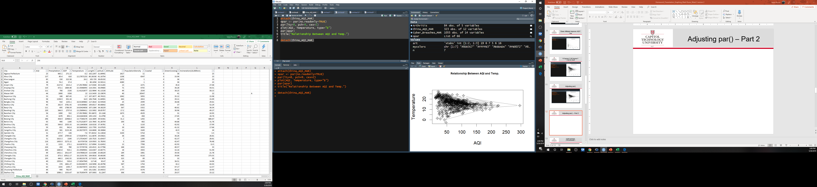
Adjusting par() – Part 2
par() function
cex=2 (bigger)

Slide 14
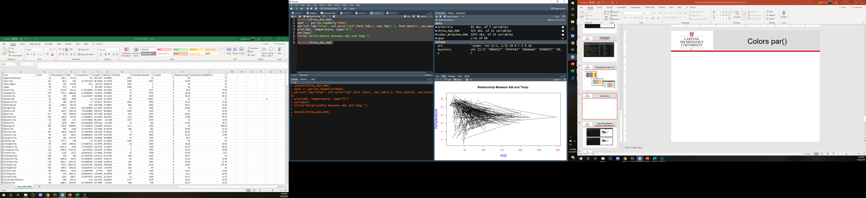
Colors par()
par() function
col.label (blue)
col.axis (red)

Slide 15
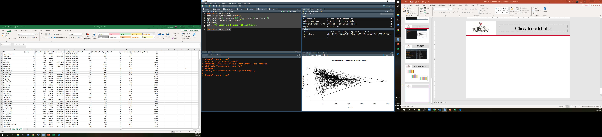
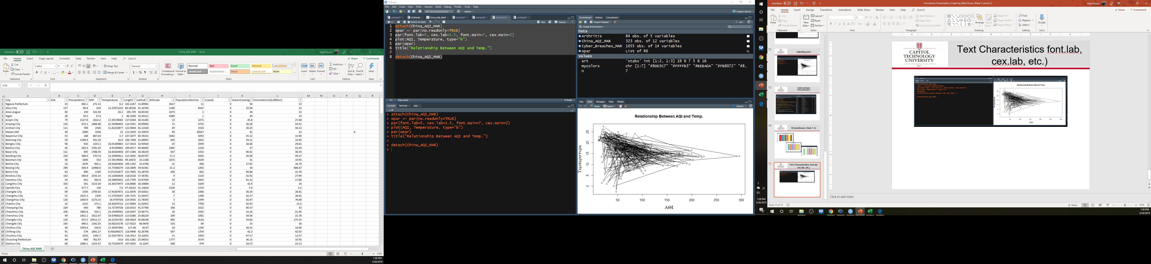
Text Characteristics
par() function
(font.lab=5, font.main=7 →
Greek

Slide 16
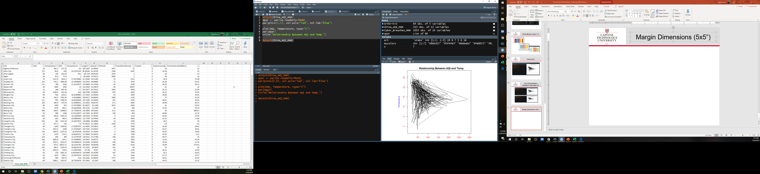
Margin Dimensions (5”x5”)
Square

Slide 17
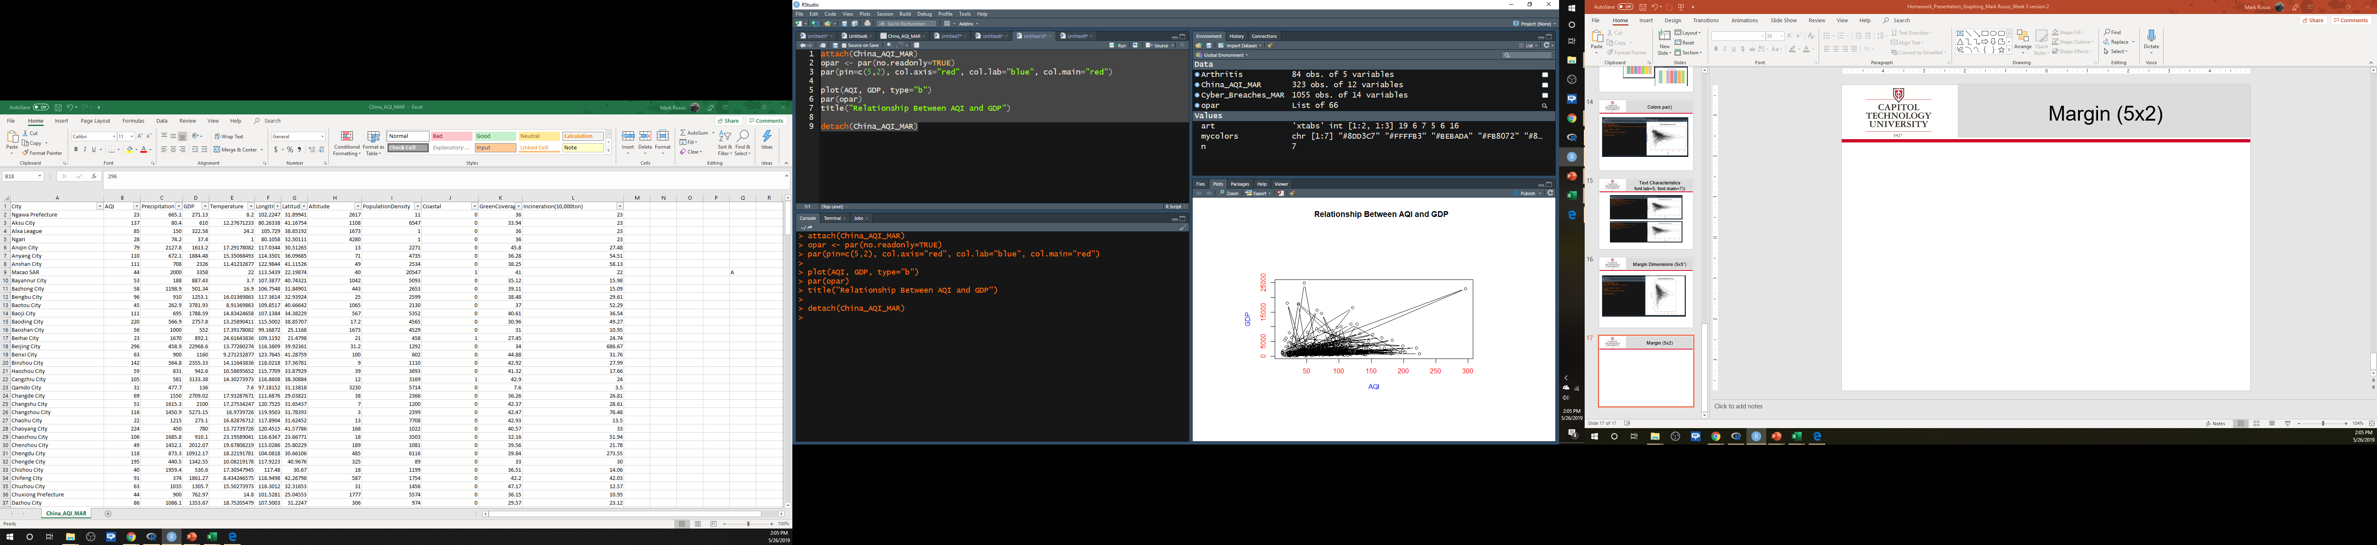
Margin (5”x2”)
Rectangle

Slide 18

Creating a “subtitle”

Slide 19
R Lessons Learned
Ensure enough quantitative data for true graphics work
“Sandwich” between attach and detach
Jpeg() not jpg() for file save/conversion
Col() seems to work well with plain English “color” names in quotes

